Slide 1
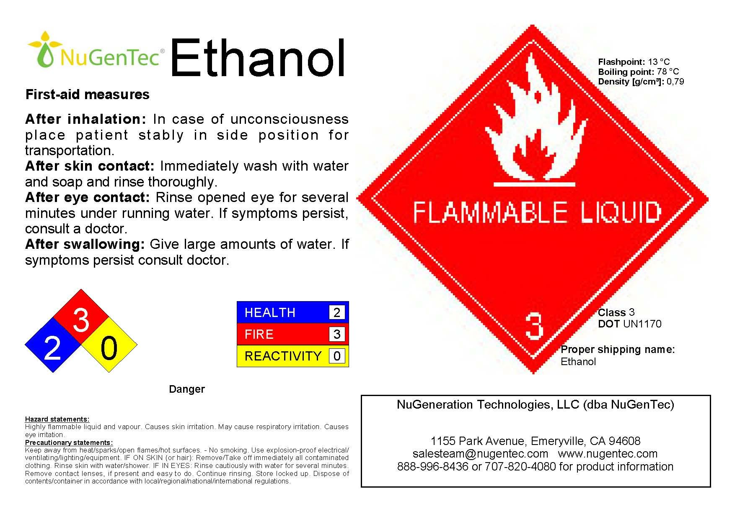
ETHANOL SAFETY GUIDELINES
First Aid Measures
After Inhalation: In case of unconsciousness place patient stably in side position for transportation
After Skin Contact: Immediately wash with water and soap and rinse thoroughly
After Eye Contact: Rinse opened eye for several minutes under running water. If symptoms persist, consult a doctor
After Swallowing: Give large amounts of water. If symptoms persists consult doctor.
DANGER
Hazard Statements
Highly flammable liquid and vapour. Causes skin irritation. May cause respiratory irritation. Causes eye irritation
Precautionary Statements
Keep away from heat/sparks/open flames/hot surfaces. No smoking. Use explosion proof electrical/ventilating/Lighting equipment. If on skin(or hair)remove /take off immediately all contaminated clothing. Rinse skin with water/shower. IF IN EYES Rinse cautiously with water for several minutes. Remove contact lenses if present. Continue rinsing.Store locked up. Dispose off contaminated container in accordance with local/region/international regulations.
EMERGENCY CONTACTS

Slide 2
ETHANOL SAFETY GUIDELINES
EMERGENCY CONTACTS

Slide 3

ETHANOL

Slide 4

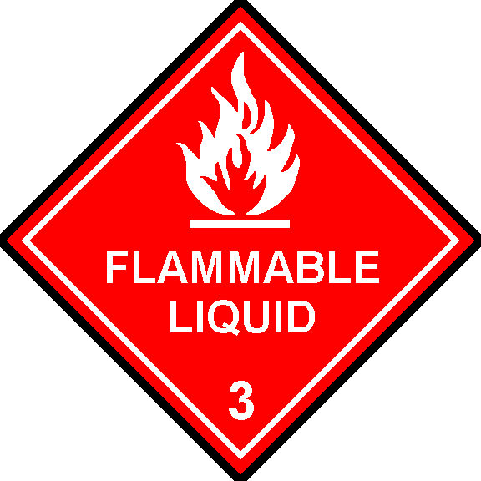
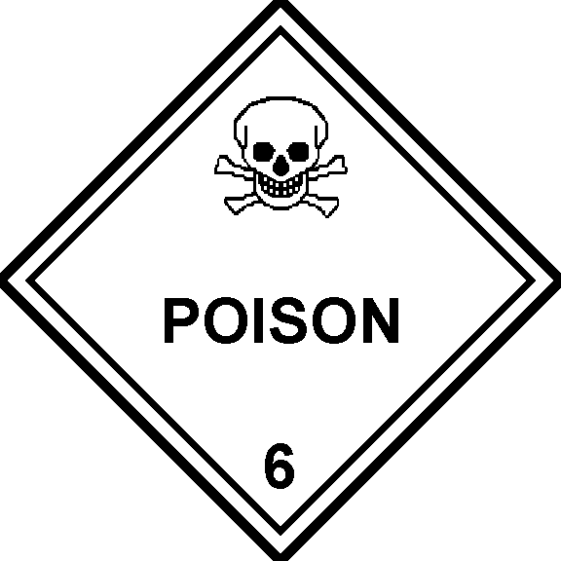
METHANOL

Slide 5
DISTILLED WATER

Slide 6

FUEL

Slide 7
FUEL
INSIDE

Slide 8
CLEAN EMPTY CONTAINERS

Slide 9

FOR USE
BY TRAINED OPERATOR ONLY

